Slide 1
Module-01
Linked List , Stack , Queue

Slide 2
Data Structures
Organized ways to store and manipulate data.
Real-Time Applications
Databases: Efficient storage and retrieval.
Operating Systems: Process scheduling.
Networking: Routing and data packet management.
Web Development: Session and state management.
AI/ML: Data preprocessing and model representation.

Slide 3
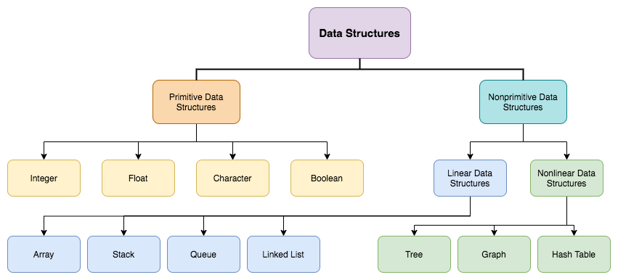

Slide 4
Arrays
Collection of elements of same type , identified by index.
Characteristics:
Fixed size.
Random access.
Homogeneous data.
Syntax
int[] numbers = {1, 2, 3, 4}; System.out.println(numbers[2]);

Slide 5
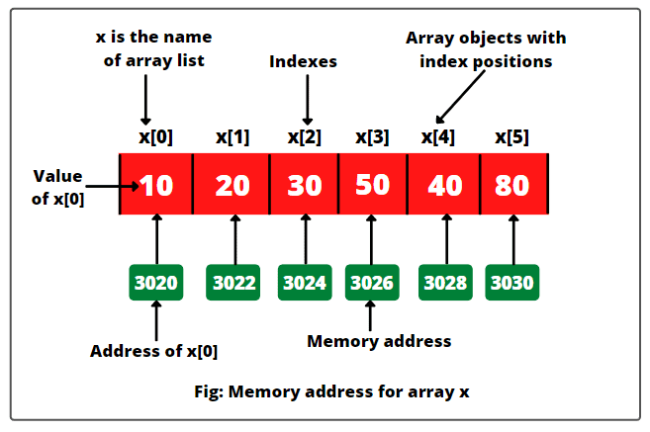

Slide 6
Advantages:
Fast access.
Disadvantages:
Static size.
Insertion/Deletion is costly.

Slide 7
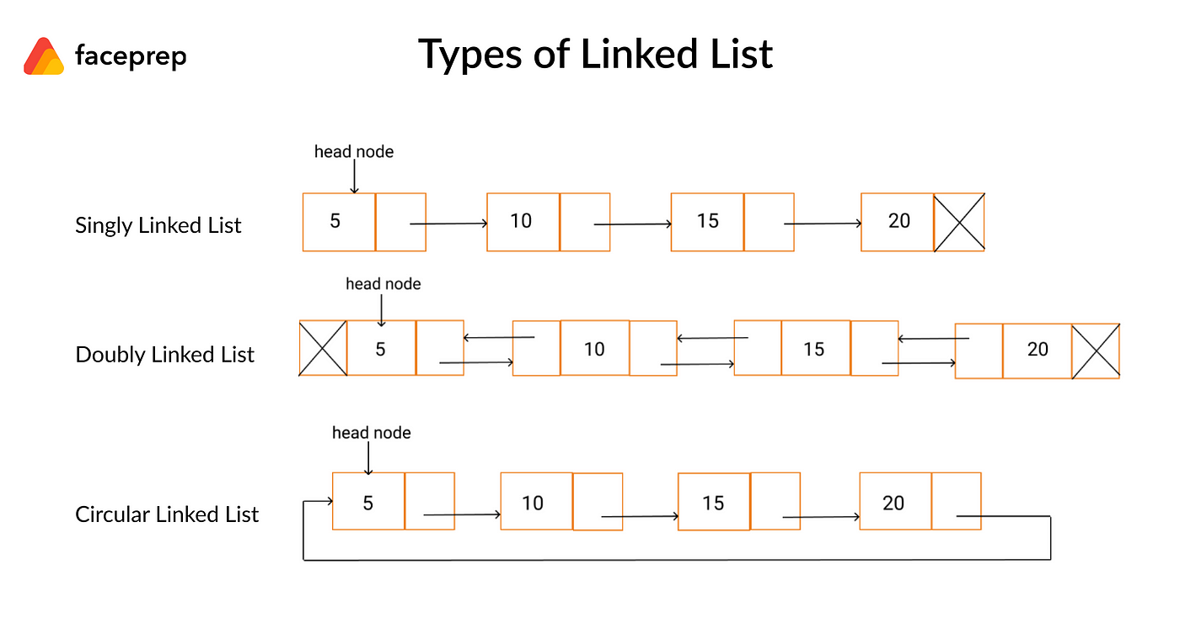
Linked Lists
Sequence of nodes, where each node points to the next.

Slide 8
Advantages:
Dynamic size.
Easier insertion/deletion.
Disadvantages:
No random access.
Higher memory usage.

Slide 9
Components of a Linked List
Node Structure:
Data: Holds the value.
Next: Pointer/reference to the next node.
Head:
Points to the first node.
Tail:
(Optional) Points to the last node.

Slide 10
Node Creation
class Node
{
int data;
Node next;
Node(int data) {
this.data = data;
this.next = null;
}
}

Slide 11
Insertion in linked list
Insertion at the Beginning
Insert a Node after a Given Node in the Linked List
Insert a Node at the End of Linked List

Slide 12
Insertion in the beginning of the LL
void insert(int data) {
Node newNode = new Node(data);
if (head == null) {
head = newNode;
}
else {
newnode.next=head;
head=newnode;
} }

Slide 13
Insertion at the end of the linkedlist
void insert(int data) {
Node newNode = new Node(data);
if (head == null) {
head = newNode;
} else {
Node temp = head;
while (temp.next != null) {
temp = temp.next;
}
temp.next = newNode;
}

Slide 14
Insertion at some position in a linkedlist
else {
ListNode curr = head;
while (--pos != 0)
curr = curr.next;
newnode.next = curr.next;
curr.next = newnode;
}
} else
System.out.println("Invalid Positon");
}
static void InsertatPositon(int value, int pos) {
ListNode newnode = new ListNode(value);
int len = Length();
if (pos <= len) {
if (pos == 0) {
newnode.next = head;
head = newnode;
}

Slide 15
Displaying Linked List
void display() {
Node temp = head;
while (temp != null) {
System.out.print(temp.data + " -> ");
temp = temp.next;
}
System.out.println("null");
}

Slide 16
Loop Detection
public static boolean detectloop()
{
Node5 slow=head;
Node5 fast=head;
while(fast!=null && fast.next!=null)
{
slow=slow.next;
fast=fast.next.next;
if(slow==fast)
return true;
}
return false;
}

Slide 17
Form Cycle
public static boolean formcycle(int a,int b)
{
int x=1;
Node5 p1=head;
Node5 p2=head;
while(p1.data!=a || x!=b)
{
if(p1.data!=a)
{
p1=p1.next;
if(p1.next==null)return false;
}
if(x!=b)
{
p2=p2.next;
x++;
} }
p2.next=p1;
return true;
}

Slide 18
Doubly Linked List
class Node {
int data;
Node next;
Node prev;
public Node(int data) {
this.data = data;
this.next = null;
this.prev = null;
}
}

Slide 19
public void addNode(int data) {
Node newNode = new Node(data);
if(head == null) {
head = tail = newNode;
head.previous = null;
tail.next = null;
}
else {
tail.next = newNode;
newNode.previous = tail;
tail = newNode;
tail.next = null;
}
}

Slide 20
Sort the bitonic DLL
static Node sortBitonicDLL(Node head) {
if (head == null || head.next == null) return head;
Node last = head;
while (last.next != null) {
last = last.next;
}
Node front = head;
Node result = null;
Node tail = null;

Slide 21
while (front != null && last != null && front != last && last.next != front) {
Node newNode;
if (front.data < last.data) {
newNode = new Node(front.data);
front = front.next;
} else {
newNode = new Node(last.data);
last = last.prev;
}
if (result == null) {
result = newNode;
tail = result;
} else {
tail.next = newNode;
newNode.prev = tail;
tail = tail.next;
}
}

Slide 22
while (front != null && front != last.next) {
Node newNode = new Node(front.data);
front = front.next;
tail.next = newNode;
newNode.prev = tail;
tail = tail.next;
}
while (last != null && last.next != front) {
Node newNode = new Node(last.data);
last = last.prev;
tail.next = newNode;
newNode.prev = tail;
tail = tail.next;
}
return result;
}

Slide 23
Segregate even and odd nodes in a LL
public static void segregate()
{
Node6 even_start=null;
Node6 even_end=null;
Node6 odd_start=null;
Node6 odd_end=null;
Node6 curr=head;
while(curr!=null)
{
int ele=curr.d;

Slide 24
if(ele%2==0)
{
if(even_start==null)
{
even_start=curr;
even_end=curr;
}
else
{
even_end.next=curr;
even_end=even_end.next;
}
}

Slide 25
else
{
if(odd_start==null)
{
odd_start=curr;
odd_end=curr;
}
else
{
odd_end.next=curr;
odd_end=odd_end.next;
}
}
curr=curr.next;
}

Slide 26
if(odd_start==null || even_start==null)
return;
even_end.next=odd_start;
odd_end.next=null;
head=even_start;
}

Slide 27
Merge Sort Principle
Divide: Split the list into two halves using a mid node. The first half runs from the head to just before mid, and the second half starts at mid and runs to the end.
Recursively Sort: Apply MergeSort recursively on both halves.
Merge: Merge the two sorted halves into one sorted list and return the new head node.

Slide 28
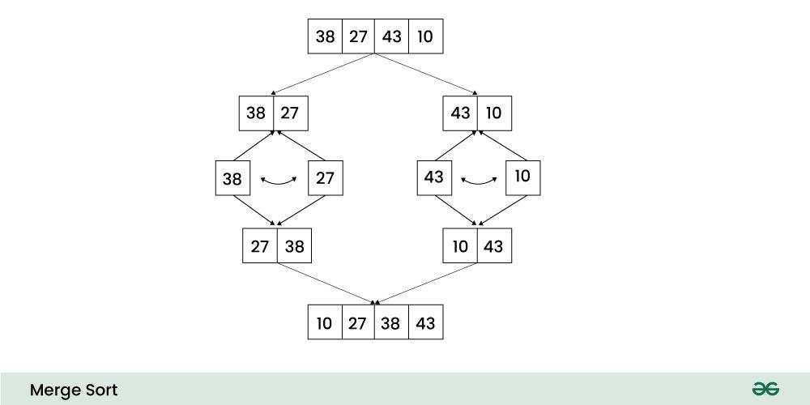

Slide 29
Merge Sort for Doubly Linked List
Input: 10 <-> 8 <-> 4 <-> 2
Output: 2 <-> 4 <-> 8 <-> 10
Input: 5 <-> 3 <-> 2
Output: 2 <-> 3 <-> 5

Slide 30
static Node MergeSort(Node head) {
if (head == null || head.next == null) {
return head;
}
Node second = split(head);
Node first = MergeSort(head);
second = MergeSort(second);
return merge(first, second);
}

Slide 31
Dividing
static Node split(Node head) {
Node fast = head,slow = head;
while (fast != null && fast.next != null && fast.next.next != null) {
fast = fast.next.next;
slow = slow.next;
}
Node temp = slow.next;
slow.next = null;
if (temp != null) {
temp.prev = null;
}
return temp;
}

Slide 32
Merging
static Node merge(Node first, Node second) {
if (first == null) return second;
if (second == null) return first;
if (first.data < =second.data) {
first.next = merge(first.next, second);
if (first.next != null) {
first.next.prev = first;
}
first.prev = null;
return first;
}
else {
second.next = merge(first, second.next);
if (second.next != null) {
second.next.prev = second;
}
second.prev = null;
return second;
}
}

Slide 33
Stack
Stack is a linear data structure that follows LIFO (Last In First Out) Principle.
It means both insertion and deletion operations happen at one end only.
Basic Operations on Stack:
In order to make manipulations in a stack, there are certain operations provided to us.
push() to insert an element into the stack
pop() to remove an element from the stack
top() Returns the top element of the stack.
isEmpty() returns true if stack is empty else false.
isFull() returns true if the stack is full else false.

Slide 34
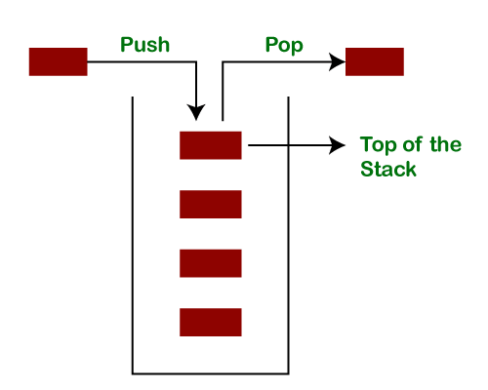

Slide 35
Types of Stack
Fixed Size Stack (using arrays)
Dynamic Size Stack (using linkedlist)

Slide 36
Stack using arrays
public class Stack_Array {
static int top=-1;
static int maxcap=1000;
static int arr[]=new int[maxcap];
static boolean isfull()
{
return top==maxcap-1;
}

Slide 37
static boolean isempty()
{
return top==-1;
}
static void push(int e)
{
if(isfull())
System.out.println("can't insert element");
else
arr[++top]=e;
}

Slide 38
static void pop()
{
if(isempty())
System.out.println("can't perform deletion");
else
top--;
}
static void top()
{
if(isempty())
System.out.println("No peek element");
else
System.out.println(arr[top]);
}

Slide 39
public static void display()
{
if(isempty())
System.out.println("no elements to display");
else
{
System.out.println("stack contains:");
for(int i=top;i>=0;i--)
{
System.out.print(arr[i]+" ");
}
}
}

Slide 40
public static void main(String[] args) {
Scanner sc=new Scanner(System.in);
int n=sc.nextInt();
for(int i=0;i<n;i++)
{
int m=sc.nextInt();
push(m);
}
top();
pop();
display();
pop();
pop();
}}

Slide 41
Stack using LinkedList
class Node3
{
int data;
Node3 next;
Node3(int e)
{
this.data=e;
this.next=null;
}
}

Slide 42
public class StackLL {
static Node3 top;
public static void push(int e)
{
Node3 newnode=new Node3(e);
if(top==null)
top=newnode;
else {
newnode.next=top;
top=newnode;
}
}

Slide 43
public static void pop()
{
if(top==null)
{
System.out.println(“No elements Stack Empty");
}
else
{
top=top.next;
}
}

Slide 44
public static void display()
{
Node3 temp=top;
while(temp!=null)
{
System.out.print(temp.data+" ");
temp=temp.next;
}
}

Slide 45
Scanner sc=new Scanner(System.in);
while(true)
{
int n=sc.nextInt();
if(n!=-1)
push(n);
else
break;
}
display();
}
}

Slide 46
Stack Implementation using Collections
import java.util.Stack;
public class Main{
public static void main(String[] args)
{
Stack<Integer> stk= new Stack<>();
boolean result = stk.empty();
System.out.println("Is the stack empty? " + result);
stk.push(78);
stk.push(113);
stk.push(90);
stk.push(120);
System.out.println("Elements in Stack: " + stk);
result = stk.empty();
System.out.println("Is the stack empty? " + result);
}
}

Slide 47
Minimum Stack
Problem: Design and implement a stack that supports push(),pop(), top() and retrieving the minimum element in constant time.
Implement a Stack class, which supports the following methods in O(1) time complexity.
void push() : Insert element onto the stack.
void pop() : Remove the top element from the stack.
int top() : Retrieve the top element in the stack.
int getmin() : Retrieve the minimum element in the stack.

Slide 48
public class Minimum_Stack
{
Stack<Integer> st;
Stack<Integer> mst;
Minimum_Stack()
{
st=new Stack<Integer>();
mst=new Stack<Integer>();
}

Slide 49
void getmin()
{
if(mst.isEmpty())
System.out.println("Stack is Empty");
else
System.out.println(mst.peek());
}
void peek()
{
if(st.isEmpty())
System.out.println("Stack is Empty");
else
System.out.println(st.peek());
}

Slide 50
void pop() {
int t=st.pop();
if(t==mst.peek())
mst.pop();
}

Slide 51
void push(int x)
{
if(st.isEmpty())
{
st.push(x);
mst.push(x);
}
else
{
st.push(x);
if(x<=mst.peek())
mst.push(x);
}
}

Slide 52
public static void main(String[] args) {
Minimum_Stack m=new Minimum_Stack();
Scanner sc=new Scanner(System.in);
int n=sc.nextInt();
for(int i=0;i<n;i++)
{
int l=sc.nextInt();
m.push(l);
}
m.getmin();
}
}

Slide 53
The Celebrity Problem
Problem: You are given a number n, representing the number of people in a party.
A celebrity is defined as somebody who knows no other person but everybody else knows him.
Print the index of the celebrity in the party, and there is no celebrity, then print "none".
Example:
Consider a party of 4 people: with the array of strings as:
0101 0000 1101 1110
In this scenario, the person with index 1 is the celebrity as everybody knows him but he does not know anybody else.
Hence, the answer will be 1.

Slide 54
Code
public class celebrity_problem
{
static boolean knows(int a,int b,int r[][])
{
return r[a][b]==1;
}

Slide 55
static int findcelebrity(int n,int m[][])
{
Stack<Integer> st=new Stack<>();
int c;
for(int i=0;i<n;i++)
st.push(i);
while(st.size()>1)
{
int a=st.pop();
int b=st.pop();
if(knows(a,b,m))
st.push(b);
else
st.push(a);
}

Slide 56
c=st.pop();
for(int i=0;i<n;i++)
{
if((i!=c) &&( knows(c,i,m) || !knows(i,c,m)))
return -1;
}
return c;
}

Slide 57
Tower of Hanoi
Tower of Hanoi is a mathematical puzzle where we have three rods (A, B, and C) and N disks. Initially, all the disks are stacked in decreasing value of diameter i.e., the smallest disk is placed on the top and they are on rod A. The objective of the puzzle is to move the entire stack to another rod (here considered C), obeying the following simple rules:
Only one disk can be moved at a time.
Each move consists of taking the upper disk from one of the stacks and placing it on top of another stack i.e. a disk can only be moved if it is the uppermost disk on a stack.
No disk may be placed on top of a smaller disk

Slide 59
Examples
Input: 2
Output: Disk 1 moved from A to B Disk 2 moved from A to C Disk 1 moved from B to C
Input: 3 Output: Disk 1 moved from A to C Disk 2 moved from A to B Disk 1 moved from C to B Disk 3 moved from A to C Disk 1 moved from B to A Disk 2 moved from B to C Disk 1 moved from A to C

Slide 60
Algorithm
Calculate the total number of moves required i.e. "pow(2, n) - 1" here n is number of disks.
2. If number of disks (i.e. n) is even then interchange destination pole and auxiliary pole.
3. for i = 1 to total number of moves:
if i%3 == 1:
legal movement of top disk between source pole and destination pole
if i%3 == 2:
legal movement top disk between source pole and auxiliary pole
if i%3 == 0:
legal movement top disk between auxiliary pole and destination pole

Slide 61
public class TowerOfHanoiUsingStack {
public static void main(String[] args) {
Scanner sc = new Scanner(System.in);
System.out.print("Enter the number of disks: ");
int numOfDisks = sc.nextInt();
if (numOfDisks <= 0)
System.out.println("The number of disks must be greater than 0.");
else
towerOfHanoi(numOfDisks);
}

Slide 62
public static void towerOfHanoi(int numOfDisks) {
Stack<Integer> source = new Stack<>();
Stack<Integer> auxiliary = new Stack<>();
Stack<Integer> destination = new Stack<>();
char s = 'S', a = 'A', d = 'D';
for (int i = numOfDisks; i >= 1; i--) {
source.push(i);
}
int totalMoves = (int) Math.pow(2, numOfDisks) - 1;
if (numOfDisks % 2 == 0) {
char temp = d;
d = a;
a = temp;
}

Slide 63
for (int i = 1; i <= totalMoves; i++) {
if (i % 3 == 1) {
moveDisks(source, destination, s, d);
} else if (i % 3 == 2) {
moveDisks(source, auxiliary, s, a);
} else if (i % 3 == 0) {
moveDisks(auxiliary, destination, a, d);
}
}
}

Slide 64
private static void moveDisks(Stack<Integer> source, Stack<Integer> destination, char s, char d) {
if (source.isEmpty()) {
int disk = destination.pop();
System.out.println("Move disk " + disk + " from " + d + " to " + s);
source.push(disk);
} else if (destination.isEmpty()) {
int disk = source.pop();
System.out.println("Move disk " + disk + " from " + s + " to " + d);
destination.push(disk);
}

Slide 65
else if (source.peek() > destination.peek()) {
int disk = destination.pop();
System.out.println("Move disk " + disk + " from " + d + " to " + s);
source.push(disk);
} else {
int disk = source.pop();
System.out.println("Move disk " + disk + " from " + s + " to " + d);
destination.push(disk);
}
}
}

Slide 66
Stock Span Problem
Problem Statement
The stock span problem is a financial problem where we have a series of N daily price quotes for a stock and we need to calculate the span of the stock's price for all N days.
The stock span problem can be solved efficiently using stack data structure.
The idea is to use a stack to maintain the prices in monotonically decreasing order. We will iterate over the price array and for each price we will find the price just greater than the current price, lying on the left side of the array.

Slide 67
Example
Input:
size = 6
arr[]={97,64,32,11,22,56}
Step 1: Traversing the given input span for 97 will be 1
Step 2: 64 is smaller than 97, so span will be 1
Step 3: 32 is smaller than 64 & 97, so span will be 1
Step 4: 11 is smaller than 97,64 & 32, so span will be 1
Step 5: 22 is greater than 11, so the span is 2
Step 6: 56 is greater than 32,11,22, so the span is 4

Slide 68
Stock Span Problem Code
public class StockSpanProblem {
public static void main(String[] args) {
Scanner sc=new Scanner(System.in);
int n=sc.nextInt();
int a[]=new int[n];
for(int i=0;i<n;i++)
a[i]=sc.nextInt();
int s[]=new int[n];
stockspan(n,a,s);
printarr(s);
}

Slide 69
public static void stockspan(int n,int a[],int s[])
{
Stack<Integer> st=new Stack<>();
st.push(0);
s[0]=1;
for(int i=1;i<n;i++)
{
while(!st.isEmpty()&&a[st.peek()]<=a[i]) {
st.pop();
}
s[i]=(st.isEmpty()?(i+1):i-st.peek());
st.push(i);
}
}

Slide 70
public static void printarr(int s[])
{
System.out.println(Arrays.toString(s));
}
}//class closing

Slide 71
Stack Permutations
You have been given two arrays having an equal number of elements. You have to find whether one array is the valid stack permutation of the other. An array is said to be a valid stack permutation of the other if and only if after applying some push and pop operations onto the sequence of elements in that array, will result in the other array.

Slide 72
Example:
Input:
arr1[] = [ 1, 2, 3 ]
arr2[] = [ 2, 1, 3 ]
Output:
YES

Slide 73
Code
public class StackPermutations {
public static boolean check(int x[],int y[],int n)
{
Stack<Integer> s=new Stack<Integer>();
int j=0;
for(int i=0;i<n;i++)
{
s.push(x[i]);
while(!s.isEmpty()&&y[j]==s.peek())
{
s.pop();
j++;
}
}
return s.isEmpty();
}

Slide 74
public static void main(String[] args) {
Scanner sc=new Scanner(System.in);
int n=sc.nextInt();
int a[]=new int[n];
int b[]=new int[n];
for(int i=0;i<n;i++)
a[i]=sc.nextInt();
for(int j=0;j<n;j++)
b[j]=sc.nextInt();
if(check(a,b,n))
System.out.println("Yes");
else
System.out.println("No");
}}

Slide 75
Queue
A Queue Data Structure is a fundamental concept in computer science used for storing and managing data in a specific order.
It follows the principle of "First in, First out" (FIFO), where the first element added to the queue is the first one to be removed.

Slide 76
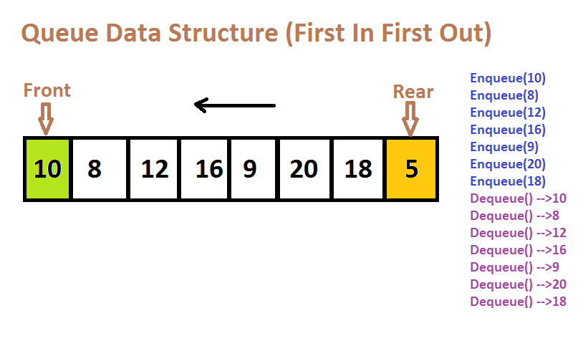

Slide 77
Queue using Arrays
public class Queue_Array {
static int maxcap = 1000;
static int[] a = new int[maxcap];
static int rear = -1, front = -1;
public static boolean isempty() {
return front == -1;
}
public static boolean isfull() {
return rear == maxcap - 1;
}

Slide 78
public static void enqueue(int e) {
if (isfull()) {
System.out.println("Queue is full! Can't insert.");
} else {
if (front == -1) {
front = 0;
}
a[++rear] = e;
}}

Slide 79
public static void dequeue()
{
if (isempty())
{
System.out.println("Queue is empty! Can't delete.");
}
else
{
System.out.println("Dequeued: " + a[front]);
front++;
if (front > rear) {
front = -1;
rear = -1;
}}}

Slide 80
public static void display()
{
if (isempty()) {
System.out.println("No elements to display!");
}
else
{
System.out.print("Queue elements: ");
for (int i = front; i <= rear; i++) {
System.out.print(a[i] + " ");
}
}
}

Slide 81
public static void main(String[] args) {
Scanner sc = new Scanner(System.in);
System.out.print("Enter the number of elements to enqueue: ");
int n = sc.nextInt();
System.out.println("Enter the elements:");
for (int i = 0; i < n; i++) {
int m = sc.nextInt();
enqueue(m);
}
display();
System.out.println("Performing two dequeue operations...");
dequeue();
display();
}}

Slide 82
Queue using LinkedList
class Node{
int data;
Node next;
Node(int v)
{
data=v;
next=null;
}
}

Slide 83
public class Queue_LinkedList {
static Node rear,front;
public static boolean isempty(){
return rear==null;
}
public static void enqueue(int ele){
Node newnode=new Node(ele);
if(rear==null)
front=rear=newnode;
else
{
rear.next=newnode;
rear=newnode;
}}

Slide 84
public static void dequeue(){
if(isempty())
System.out.println("no elements to delete");
else
front=front.next;
}
public static void display(){
Node temp=front;
while(temp!=rear)
{
System.out.print(temp.data+" -> ");
temp=temp.next;
}
System.out.println();
}

Slide 85
public static void main(String[] args) {
Scanner sc=new Scanner(System.in);
int n=sc.nextInt();
for(int i=0;i<n;i++)
{
int ele=sc.nextInt();
enqueue(ele);
}
display();
dequeue();
dequeue();
display();
}}

Slide 86
Priority Queue
A priority queue is an abstract data type that behaves similarly to the normal queue except that each element has some priority, i.e., the element with the highest priority would come first in a priority queue.
The priority of the elements in a priority queue will determine the order in which elements are removed from the priority queue.
The priority queue supports only comparable elements, which means that the elements are either arranged in an ascending or descending order.
For example, suppose we have some values like 1, 3, 4, 8, 14, 22 inserted in a priority queue with an ordering imposed on the values is from least to the greatest. Therefore, the 1 number would be having the highest priority while 22 will be having the lowest priority.

Slide 87
Characteristics of a Priority queue
A priority queue is an extension of a queue that contains the following characteristics:
Every element in a priority queue has some priority associated with it.
An element with the higher priority will be deleted before the deletion of the lesser priority.
If two elements in a priority queue have the same priority, they will be arranged using the FIFO principle.

Slide 88

Priority Queue using DLL
Priority queue is abstract data type which behave similar to the linear queue except that each element has priority.
Example:
Hospital Emergency Queue
The patients will be treated according to their medical condition. (i.e: Person in pain – High priority).

Slide 89
Priority Queue using DLL
Example:
Priority
1
2
3
4
5
Front
Deletion
Rear
Insertion
The priority of the elements in the priority queue will determine the
order of removal of the data elements.

Slide 90

import java.util.*;
class Main {
static class Node {
int data;
int priority;
Node next, prev;
public Node(int data, int priority) {
this.data = data;
this.priority = priority;
}
}
private static Node head = null;
1
2
3
4
5
6
7
8
9
10
11
12
13
14
15
16
17
18
19
20
21
22

Slide 91
private static void push(int data, int priority) {
if (head == null) {
Node newNode = new Node(data, priority);
head = newNode;
return;
}
Node node = new Node(data, priority);
Node temp = head, parent = null;
while (temp != null && temp.priority >= priority) {
parent = temp;
temp = temp.next;
}
if (parent == null) {
node.next = head;
head.prev = node;
head = node; }
1
2
3
4
5
6
7
8
9
10
11
12
13
14
15
16
17
18
19
20
21
22

Slide 92
else if (temp == null) {
parent.next = node;
node.prev = parent;
}
else {
parent.next = node;
node.prev = parent;
node.next = temp;
temp.prev = node;
}
}
private static int peek() {
if (head != null) {
return head.data;
}
return -1; }
1
2
3
4
5
6
7
8
9
10
11
12
13
14
15
16
17
18
19
20
21
22

Slide 93
private static int pop() {
if (head != null) {
int curr = head.data;
head = head.next;
if (head != null)
head.prev = null;
return curr;
}
return -1;
}
public static void main(String[] args) {
Scanner sc=new Scanner(System.in);
int n=sc.nextInt();
for(int i=0;i<n;i++)
{
int data=sc.nextInt();
1
2
3
4
5
6
7
8
9
10
11
12
13
14
15
16
17
18
19
20
21
22

Slide 94
int pri=sc.nextInt();
push(data, pri);
}
System.out.println(peek());
System.out.println(pop());
System.out.println(pop());
System.out.println(peek());
}
}
1
2
3
4
5
6
7
8
9
10
11
12
13
14
15
16
17
18
19
20
21
22

Slide 95
Sort without extra space
Problem:
Sort the given queue without using any extra space
10
1
90
107
5

Slide 96
Code
import java.util.*;
public class Queue_Sort {
public static void main (String[] args)
{
Queue<Integer> q = new LinkedList<Integer>();
q.add(3);
q.add(1);
q.add(4);
q.add(2);
q.add(5);
sortQueue(q);
System.out.println(q);
}

Slide 97
public static void sortQueue(Queue<Integer> q)
{
for(int i = 1; i <= q.size(); i++)
{
int min_index = minInd(q,q.size() - i);
insertMinToRear(q, min_index);
}
}

Slide 98
public static int minInd(Queue<Integer> q, int sortIndex) {
int min_index = -1;
int min_value = Integer.MAX_VALUE;
int s = q.size();
for (int i = 0; i < s; i++) {
int current = q.poll();
if (current <= min_value && i <= sortIndex) {
min_index = i;
min_value = current;
}
q.add(current);
}
return min_index;
}

Slide 99
public static void insertMinToRear(Queue<Integer> q, int min_index)
{
int min_value = 0;
int s = q.size();
for (int i = 0; i < s; i++) {
int current = q.poll();
if (i != min_index)
q.add(current);
else
min_value = current;
}
q.add(min_value);
}
}

